Slide 1


analysis on fossil fuels

Slide 2
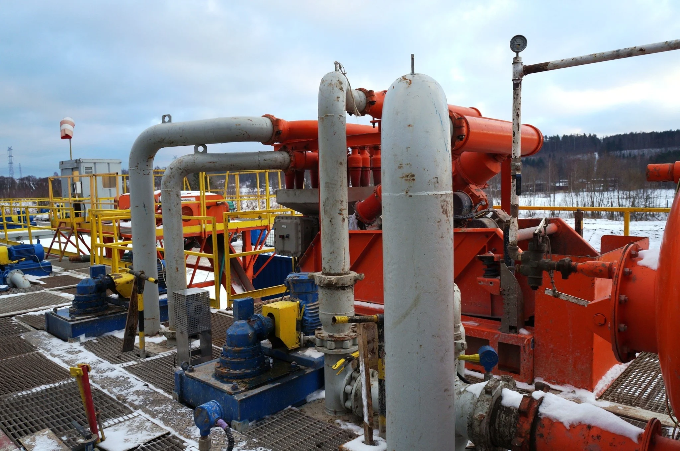
GAS PRODUCTION ANALYSIS
1. Evolution of the Gas Production (1900 – 2024) in TWH
2. USA in the Gas Production (1900 – 2024) in TWH
3. The 3 Countries producing the most Gas

Slide 3
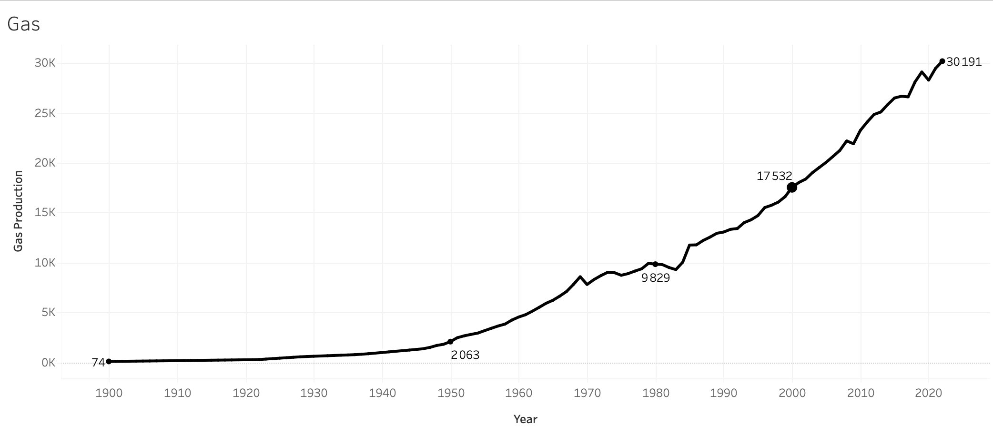
EVOLUTION OF THE GAS Production (1900 – 2024) in TWH
Production was able to increase 28-fold during the first half of the 20th century and has continued to grow at a sustained rate ever since.
Production x28, with slowdowns during the two World Wars
From 2,063TWh to 30,191TWh between 1950 and 2020
WW II : slowdown in production
WW1 : slowdown in production

Slide 4
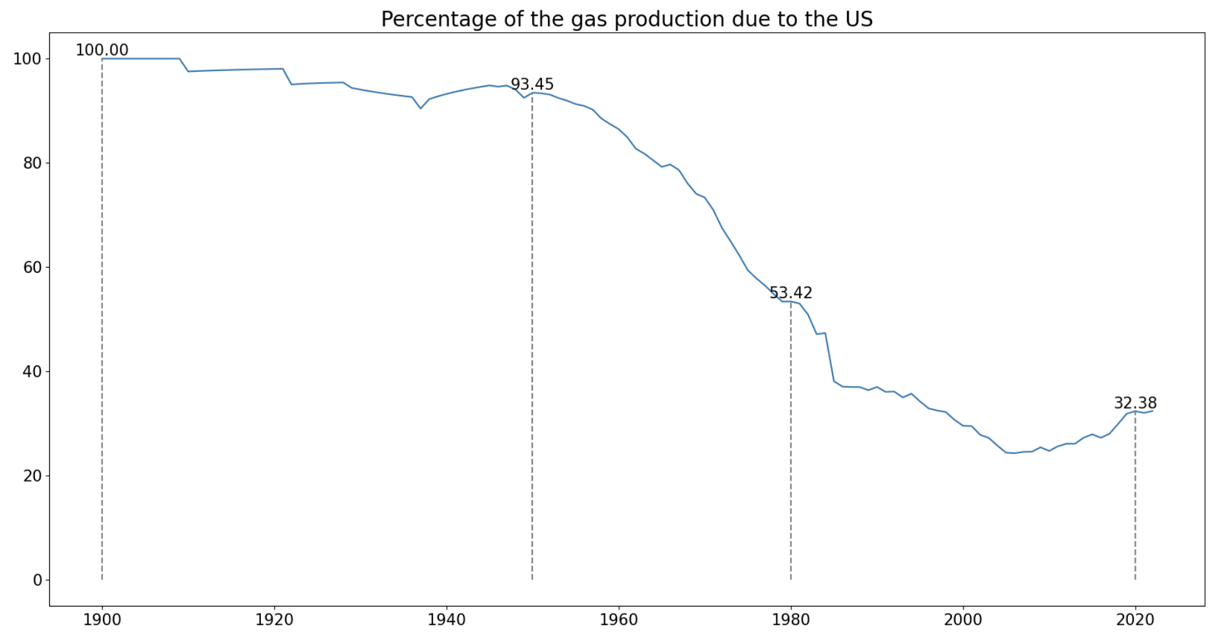

USA IN THE GAS Production (1900 – 2024) in TWH
The USA has been the leading producer of gas since 1900. However, its share has tended to decrease since 1950.

Slide 5





THE 3 COUNTRIES PRODUCING THE MOST GAS
Even if the US share declines, no country seems capable of overtaking it in the short term.
1950
1980
2020

Slide 6
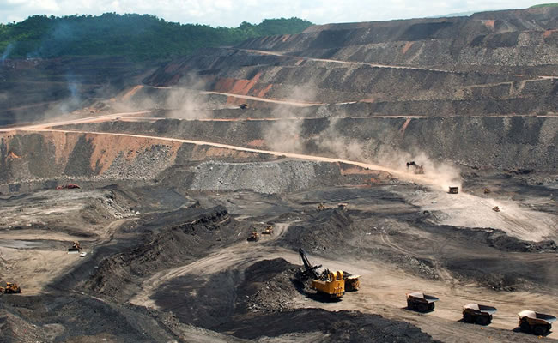
COAL PRODUCTION ANALYSIS
1. Evolution of the Coal Production (1900 – 2024) in TWH
2. The 3 Countries producing the most Coal

Slide 7
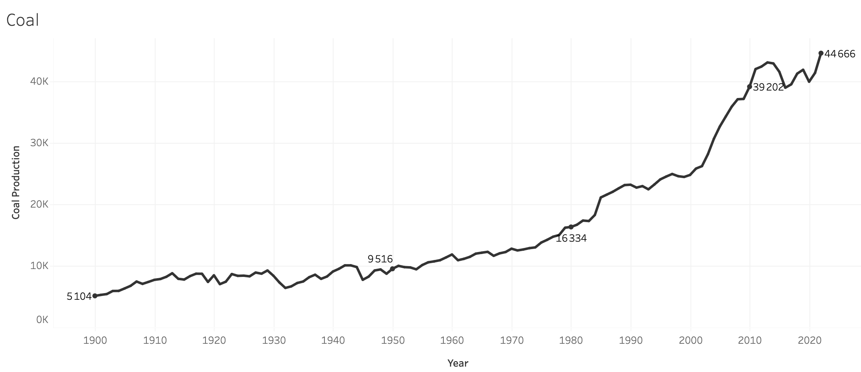


EVOLUTION OF THE COAL Production (1900 – 2024) in TWH
Two phases of major growth can be distinguished: the beginning of the 20th century in Europe and from 1980 in China.
Growth driven by the Industrial Revolution in Western countries
Growth driven by China

Slide 8


THE 3 COUNTRIES PRODUCING THE MOST Coal
The USA was a leader in the 20th century but is no longer in the top 3 in 2020.
1950
1980
2020

Slide 9

OIL PRODUCTION ANALYSIS
1. Evolution of the Oil Production (1900 – 2024) in TWH
2. The 3 Countries producing the most Oil

Slide 10
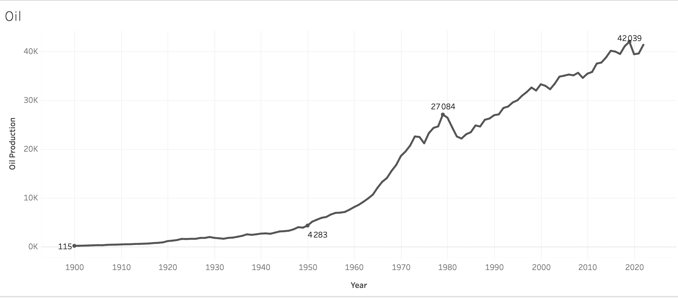



EVOLUTION OF THE OIL Production (1900 – 2024) in TWH
The USA was the first country to exploit its oil deposits, before Middle Eastern countries exploited even larger reserves.
Production driven by the US, thanks to huge reserves
Middle East become the first producer

Slide 11
THE 3 COUNTRIES PRODUCING THE MOST Oil
Despite the emergence of Middle Eastern countries, the USA remains the leader in global oil production thanks to new drilling and extraction techniques.
1950
1980
2020

